Slide 1
CE Department
in a Glance

Slide 2
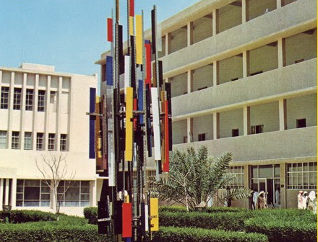
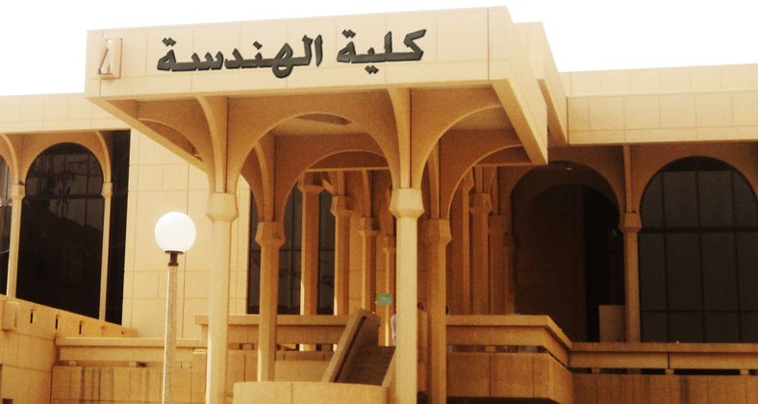
CE Over the Years
Established in 1382 H (1962 G).
Produced more than 4000 Engineers
CE alumnus play key roles in public and private sectors (Ministers, Ambassadors, CEO’s, … etc.)
CE department has always been the drive engine for college of Engineering in term of management and students

Slide 3
Vision
To be a world-class department in civil engineering education, innovation and technological advancement.
Mission
Excellence in quality and sustainability.
Highly qualified civil engineers
Knowledge sharing, innovative research, and continuing education and professional development.

Slide 4
CE Capabilities

Slide 5
CE Capabilities

Slide 6
CE Capabilities

Slide 7
CE Capabilities (NEED More Work)
Main Laboratory | Associated Units | SRVICES
Structural Engineering | Structure Lab Concrete Lab Material Testing Lab Impact Research Lab Mechanics of Material & Statics Lab | Chemical Composition Analysis Structural Assessment and Rehabilitation Dynamic testing of structural elements
Environmental Engineering | -
Hydraulics & Fluid Mechanics | Hydraulics Lab Fluid Mechanics Lab
Soil Mechanics (Geotechnical) | Research Chair Lab
Transportation Engineering | -
Survey Engineering | -

Slide 8
Society Contribution-Advancement of CE
Dissemination of Saudi Building Code (SBC)
SBC 301
Loading and Forces
SBC 302
Construction
SBC 303
Soil and Foundations
SBC 304
Concrete Structures
SBC 305
Masonry Structures
SBC 306
Steel Structures

Slide 9
Society Contribution- High profile projects
Two Holy Mosques:
Structural Integrity Assessment
Over-seeing designs and plans of the new extension
Ministry of Education Mega Projects
XXX
XXX
Effective Participation in global Completions
Solar Decathlon Competition

Slide 10
CE Ambitions- Students Development
Internships
Capstone Projects
Employment Opportunities
Enablement of Creativity

Slide 11
CE Ambitions- Faculty Empowerment
Research Implementation
Cooperative Partnership
Mutual Knowledge Transfer

Slide 12
CE Ambitions- Sustainable Department
Utilization of Lab. Capabilities
Hosting Related Programs (e.g., conferences, prizes, short courses, … etc.)
Maintain and Grow Effective Alumni Association

Slide 13
Where Does Advisory Board Fit?

Slide 14
Thank You!

